Slide 1
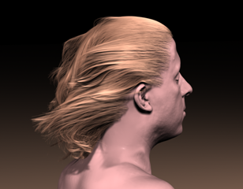
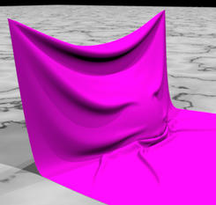
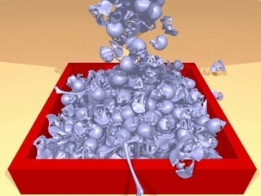
Chapter 5-3 Physically Based Simulation
Particle System

Slide 2
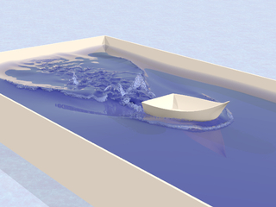
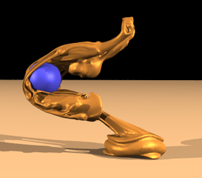
Content
Overview
Cloth Simulation
Particle System
Fluid Simulation
Hair Modeling & Simulation
Summary

Slide 3
5.3.1 Overview
Type of Group | Number of elementts | Incorporated | Intelligence
Particles | Many | Much – with environment | None
Flocks | Some | Some – with environment and other elements | Limited
Autonomous Behavior | Few | Little | Much
Particle systems are a method of rendering complex objects that are not easily described by polygonal geometry but, could resemble a huge collection of small points in space or a fuzzy object

Slide 4
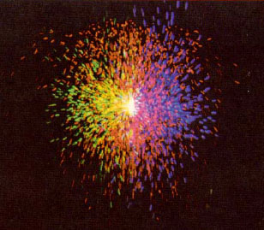
What’s a Particle System?
5.3.1 Overview
A collection of many minute particles that together represent a fuzzy object
Use points to define shapes rather than polygons

Slide 5
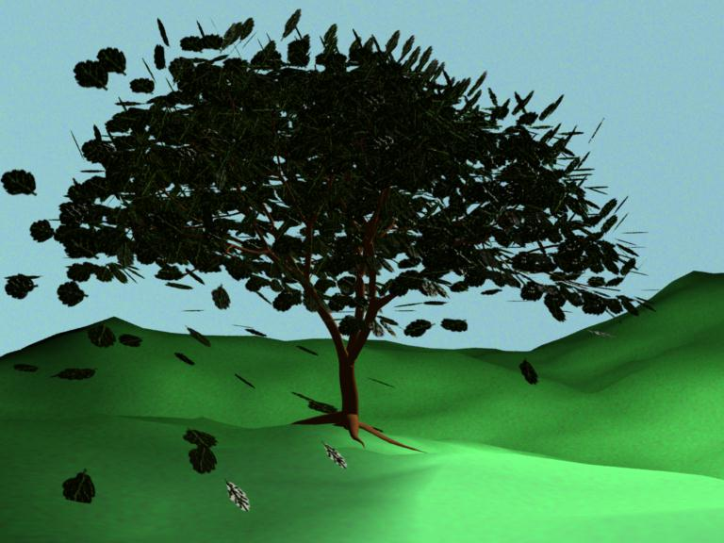
Advantages
5.3.1 Overview
Simple – points rather than polys
Procedural
Random
Models that are “alive”

Slide 6
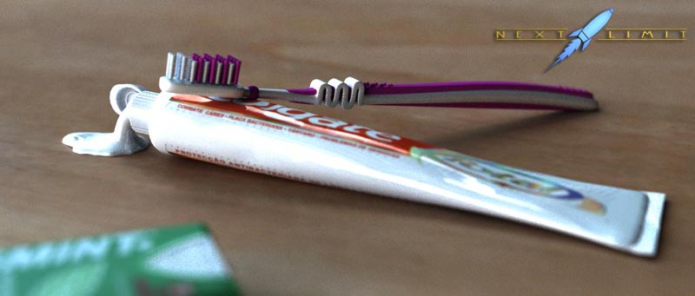
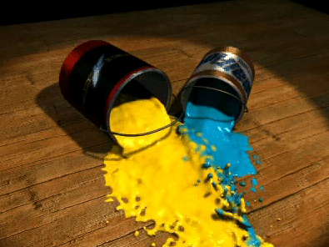
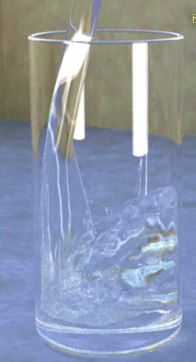
(1) Particle Systems and Fuzzy Shapes
William T. Reeves
Particle Systems – A Technique for Modeling a Class of Fuzzy Objects
SIGGRAPH 83

Slide 7

(2) Fuzzy objects
Do not have smooth, well-defined, and shiny surfaces
Irregular, complex, and ill-defined
Soft, deformable objects

Slide 8
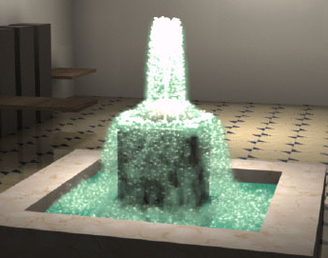
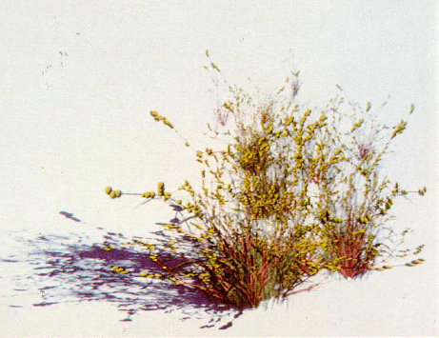
(3) Some fuzzy objects
Grass, smoke, fire, clouds, water
Fireworks, explosions
Fluid flow
Physical simulations
Flocking
Bird migration
schools of fish
riots

Slide 9
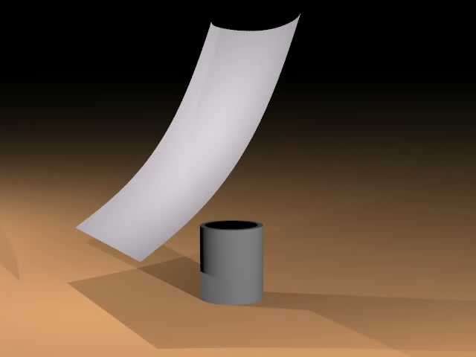
(3) Some fuzzy objects

Slide 10

(3) Some fuzzy objects

Slide 11
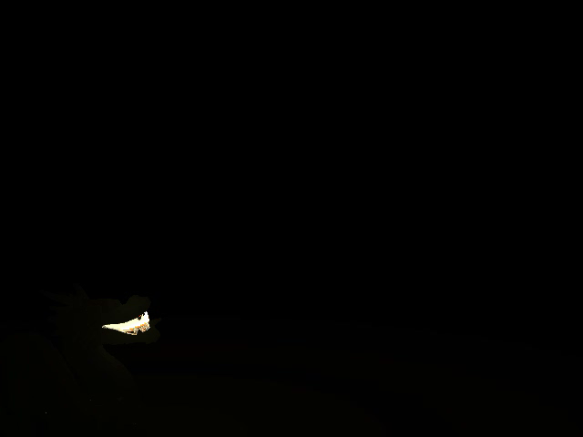
(3) Some fuzzy objects

Slide 12
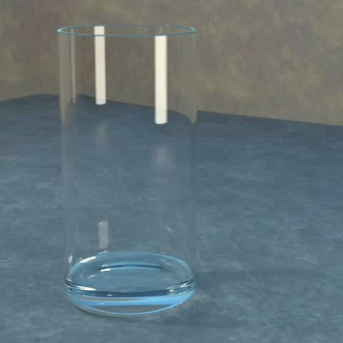
(3) Some fuzzy objects

Slide 13
5.3.2 Life of a Particle
Particle Systems
Large Number of Elements
Simplify Assumptions for
Rendering and Motion calculations
No particle-particle collisions
No shadow casting (except in aggregate sense)
No shadow casting on the environment
No light reflection (each particle modeled as point light sources)
Notes:
shadow cast 投影
aggregate
n.合计, 总计, 集合体
adj.合计的, 集合的, 聚合的
v.聚集, 集合, 合计

Slide 14
Born → Live → Die, the life of a particle
5.3.2 Life of a Particle
Particles enter the system
They are given individual attributes
Particles in the system that have exceeded their lifetime are extinguished
Live particles are moved and transformed according to their attributes
Particles are rendered

Slide 15
5.3.2 Life of a Particle
One frame of motion
Generate new particles
Assign attributes to each particle
Terminate any particle with expired life span
Animate remaining particles
Change shading parameters
Render the particles

Slide 16
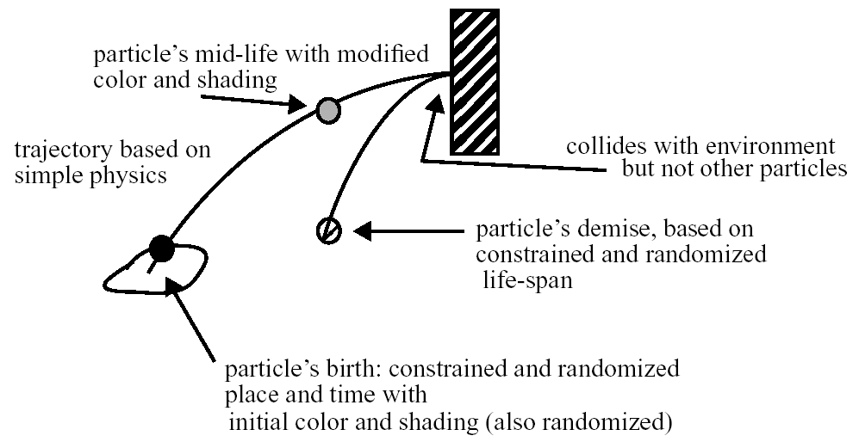
5.3.2 Life of a Particle

Slide 17

(1) For each frame
Reaction to environment
Aging: Time-varying attributes
birth
Source
death

Slide 18
(2) Birth
Set rate at which particles enter the system
Control mean number of particles entering
or
Control mean number of particles entering per unit area of screen
Adjust size of object by changing the rate at which particles enter the system

Slide 19
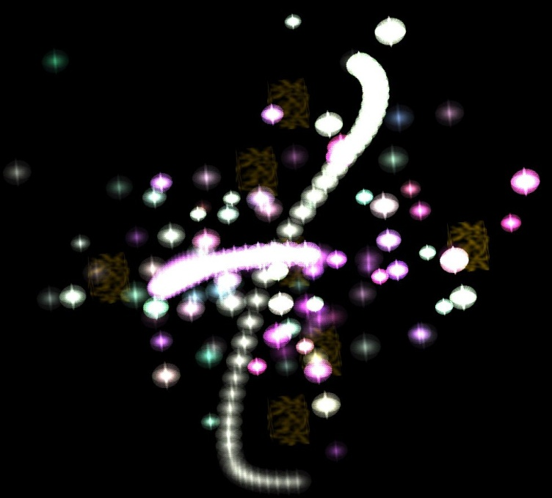
1) Particle Attributes
Position
Velocity vector
Size, color, transparency
Shape
Lifetime

Slide 20

2) Particle Generation
Controlled stochastic process
# of particles = average + Rand() * range * (screenArea)
Attributes:
Position
Velocity
Shape parameters
Color
Transparency
Lifetime

Slide 21
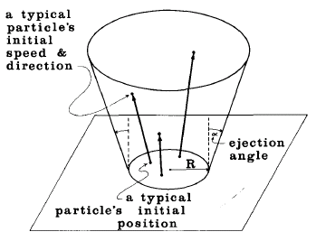
3) Assign Random Properties
Value = mean + Rand()*variance
Need a good random number seed

Slide 22
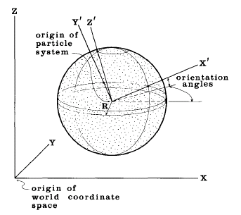
4) Generation Shape
What initial shape do we want the particle system to have?

Slide 23
(3) Life
At each frame, add velocity vector to position vector
Add additional accelerations such as gravity
Causes particles to move in parabolic arcs
Notes:
parabolic 抛物线

Slide 24
(4) Death
Lifetime of a particle defined at birth to be a certain number of frames
Or, kill particles
That are not visible
When they are a certain distance from the origin
After a certain time interval
Below a threshold intensity

Slide 25
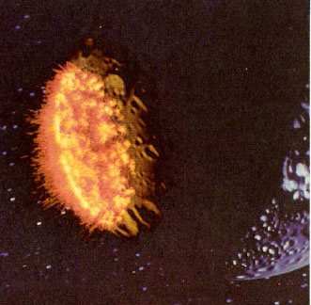
5.3.3 Particle Rendering
Rendering Difficulties
Particles obscure other particles
Particles can cast shadows and be transparent
Polygon primitives interact with particles
Assume particles do not intersect with each other or surface primitives
Assume particles are point light sources
Star Trek II: The Wrath of Khan

Slide 26
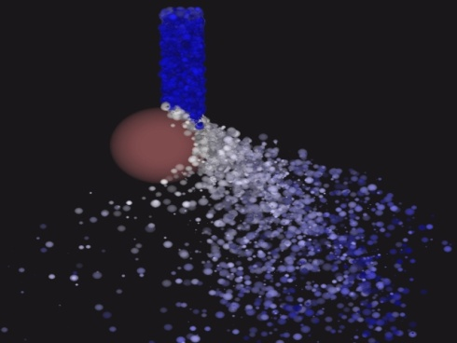
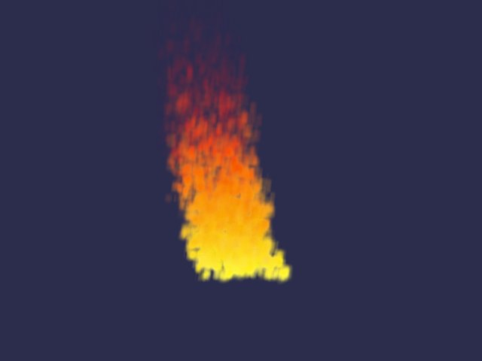
Rendering a Particle
Each particle → a single point, line, sphere, or complex polygonal object.
The advantage of spheres is that no matter how you rotate them, if there is no texturing on them, they will look the same.
Doubly linked list → particles can be easily moved from one pool to another.
Alive pool → contains particles that should be rendered to the screen because they are currently active
Dead pool → reserve of allocated particle space that may be needed later or have exceeded their lifetime.
Cube is never rotated
A lookup table → the correct depth of a point inside the cube
A-buffer → take a list of particles and correctly render them to the screen

Slide 27
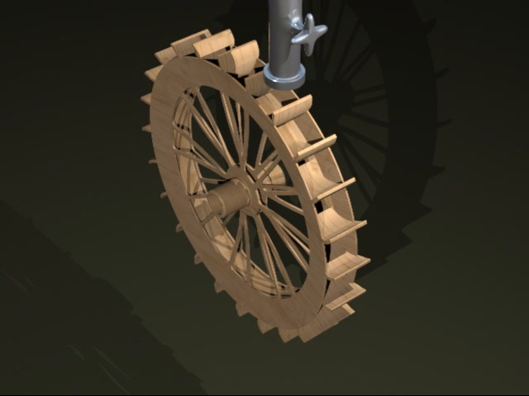
Demo

Slide 28
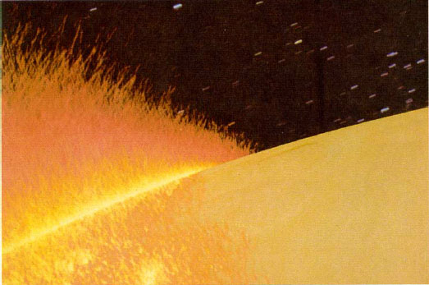
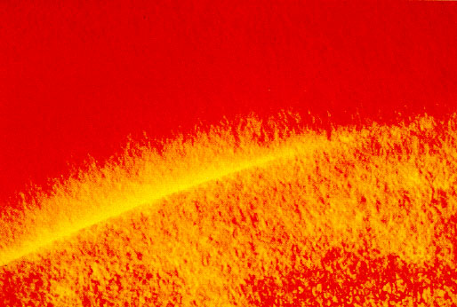
A particle behind another particle is not obscured by rather adds more light to the pixels covered

Slide 29
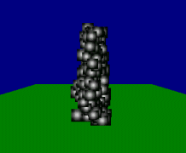
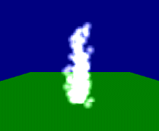

(1)Rendering a Particle → Alpha Blending
Without alpha-blending : particles are simply textured rectangles.
Alpha-blending is enabled
FinalColor = DestColor × DestBlendFactor + SrcColor × SrcBlendFactor
The more particles are on top of each other, the brighter the color in that area should be

Slide 30
5.3.4 Particle System Representation
Separate the data structures and integration
State [x, v]
Particle System
particles
time
ODE(ordinary diffrential
equation) Solver
[v, f, m]
state
derivatives
Particle

Slide 31
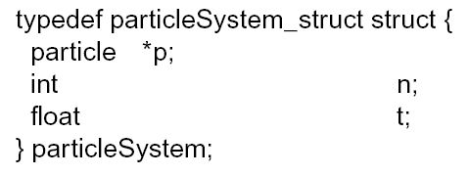
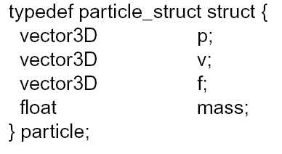
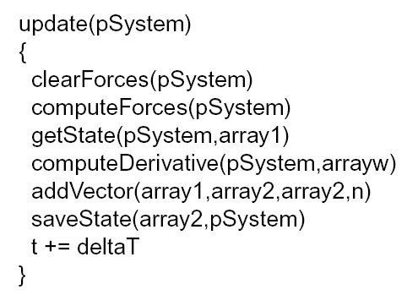
Particle System
particles
time
ODE Solver
state
derivatives

Slide 32
5.3.5 A stand-alone particle system
It utilizes an octree system for hierarchical space subdivision
Can simulate a variety of forces and boundary conditions

Slide 33
(1) Features
Automatic octree space representation (order N log N)
N-body gravitational forces
Hard-sphere contact forces, with contact-axis damping
Constant-vector gravitation force
Strand-connectivity forces, compression/tension and bending
Hard or open boundaries
Density field construction
Radiance output for particle locations
GIF, PGM output for particle locations and density field

Slide 34
(2) Limitations
No controls on stability (1st order Euler forward integrator)
No rotations involved in any calculations
Non-adaptive time step size
Inaccurate calculations when particles of different sizes are in the same simulation
You only get grey, spherical particles

Slide 35
5.3.6 Calculating the forces on one particle from all of the other particles
First, create a data structure for your particles.
Feel free to include any rendering parameters you like, because they won't affect the simulation.
Include a three-vector for position and velocity: x[3], u[3], and floats for mass and radius.
Note that the code is easier to write if you give all of your particles the same radius.

Slide 36
5.3.6 Calculating the forces on one particle from all of the other particles
Second, you need to write a routine to march through your particles and find the forces or accelerations on each one.
Remember, the acceleration is just the force divided by the particle's mass
This subroutine is where you include forces due to particle gravity ( F = G * m1 * m2 / d^2), universal gravity (F = mg), particle contact (F = -k * penetration), and others.

Slide 37
5.3.6 Calculating the forces on one particle from all of the other particles
Once you determine the accelerations on all of the particles, multiply them by the duration of the time step, and add them to the velocities.
Update the positions in a similar manner.

Slide 38
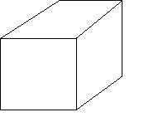
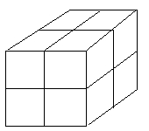
Keep in mind that the naive approach of calculating forces (nested iteration through the complete particle lists) → O(n²)
A better method → octree space subdivision:
The essence of it is that you clump particles together as one virtual mass when computing the effect of that clump of particles on a particle or clump of particles far away

Slide 39
5.3.7 Particle Hierarchies
Instead of drawing a system of particles, make a system of a system of particles!
Construct a hierarchy tree
Adds turbulence and billowing effects
Notes:
turbulence
n.骚乱, 动荡, (液体或气体的)紊乱
billow
n.巨浪, 波浪般滚滚向前的东西
v.翻腾

Slide 40
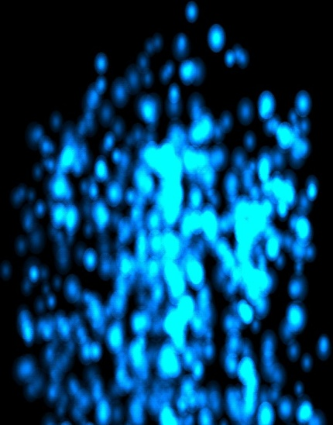
5.3.8 Dumb Particles
Particles that do not interact with each other
i.e. vortices, smoke, rain, fire
Notes:
Vortices n.旋涡

Slide 41
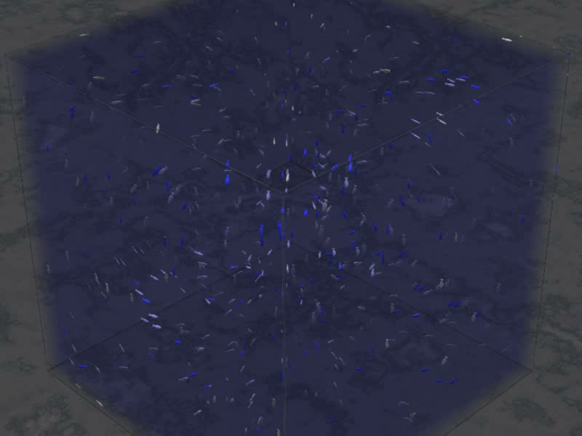
5.3.9 Smart Particles
Particles interact with each other
Useful for simulating
Flocks, herds, schools of fish (Boids 1986)
Fluids
Collisions + turbulence

Slide 42
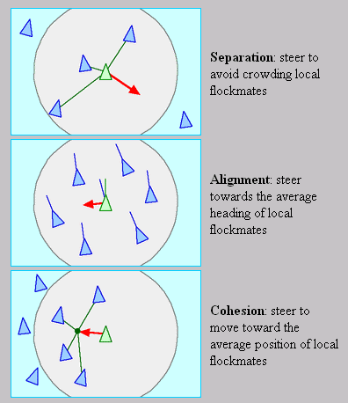
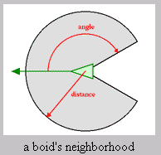
(1) Modeling Flocking Patterns
Avoid hitting one another
Point in same direction as neighbors
Steer toward average position of neighbors
Avoid danger
http://www.codepuppies.com/~steve/aqua.html

Slide 43
(2) Fluid flow modeling
Density, pressure, viscosity per particle
Particles have mass
Particles are rigid bodies that take up space
Momentum is conserved during collisions
Controlled by gravitational forces
Heat transfer
Surface tension

Slide 44
(3) Physical Simulations with Particles
Turbulence
Fluid-solid collision
Multiple fluid interactions
Heat transfer
Fracture/Explosions
Render up to 1 million particles on a PC
Can change fluid resolution

Slide 45
5.3.10 Particle Systems Details
Used for many different things from explosions to smoke to water
Basic idea:
Everything is a particle
Particles exert forces of some form on each other, and the world, and the world might push back
Simulate the system to find out what happens
Attach something to the particles to render
Different force rules and different renderings give all the different types of behaviors

Slide 46
5.3.10.1 Particle
A single particle in 2D moving in a flow field
Position
Velocity
The flow field function dictates
particle velocity

Slide 47
5.3.10.2 Vector Field
The flow field g(x, t) is a vector field that defines a velocity vector for any particle position x at any time t.
How would a particle move in this vector field?

Slide 48
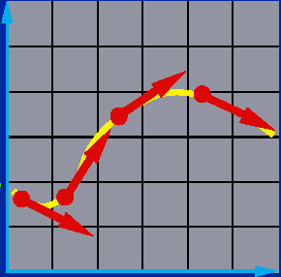
5.3.10.3 Curve
Start at an initial point
The particle trajectory follows the vectors

Slide 49
(1) Differential Equations
The equation v = g(x, t) is a first order ordinary differential equation:
The position of the particle is computed by integrating the differential equation:
For most interesting cases, this integral cannot be computed analytically.

Slide 50
(2) Numeric Integration
Instead we compute the particle’s position by numerical integration:
Starting at some initial point x(t₀)
Step along the vector field to compute the particle position at discrete time steps.
This type of a problem is called an initial value problem.

Slide 51
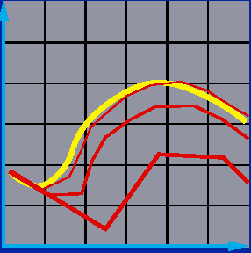
(3) Euler’s Method
The simplest solution to an initial value problem.
Discrete time steps
Bigger steps, bigger errors

Slide 52
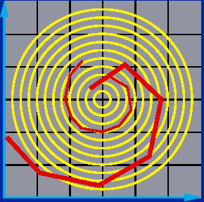
(4) Problem: Inaccuracy
Error turns x(t) from a circle into the spiral of your choice.
Notes:
spiral
adj.螺旋形的
n.螺旋
v.盘旋

Slide 53
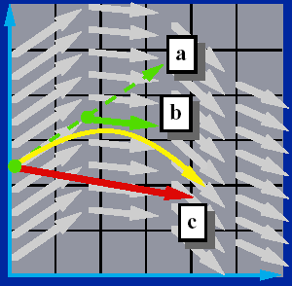
(5) Middle Point Method
Compute an Euler step
b. Evaluate g at the midpoint
c. Take a step using the midpoint value

Slide 54
(6) Other Methods
Euler’s method is the simplest numerical method. It’s first order. The error is proportional to
Middle point method is second order. The error is proportional to
Just the tip of the iceberg. See Numerical Recipes for more.
Numerical Recipes URL http://www.nr.com
Notes:
Iceberg: 冰山;（事物全貌的）一小部分;

Slide 55
5.3.10.4 Particle in a Force Field
What is a motion of a particle in a force field?
The particle moves according to Newton’s Law:
The mass m of a particle describes the particle’s inertial properties:
lighter particles are easier to move than heavier particles.
In general, the force field f(x, v, t) may depend on the time t and particle’s position x and velocity v.
Notes:
Inertial:惯性的

Slide 56
(1) Second-Order Differential Equations
Newton’s Law yields an ordinary differential equation of second order:
Add a new variable v to get a pair of coupled 1st order equations:

Slide 57
(2) Phase Space
If we define a new phase space vector y, which consists of particle’s position x and velocity v, then we can construct a new first-order differential equation and use the same numeric differentiation solvers.
Notes:
phase space
拓扑空间
相宇, 相空间

Slide 58
Particle Systems
How would we compute the motion of a particle system consisting of n particles?
Concatenating the phase space positions of all n particles yields a large first-order ordinary differential equation.
For particles in 3D, there will be 6n equations (3 equations for position and 3 equations for velocity of each particle):

Slide 59
Particle Animation
AnimateParticles(n, y₀, t₀, t_{f})
{
y = y₀
t = t₀
DrawParticles(n, y)
while(t != t_{f}) {
dydt = EvaluateDerivative(y, t)
{y, t } = ODESolverStep(6n, y, dy/dt)
DrawParticles(n, y)
}
}

Slide 60
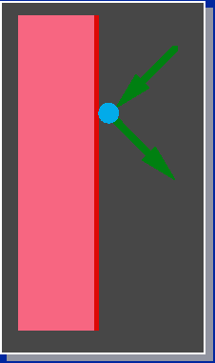
5.3.10.5 Collision Detection &Response
Bounce off the Walls
Only consider simple point-plane collisions.

Slide 61
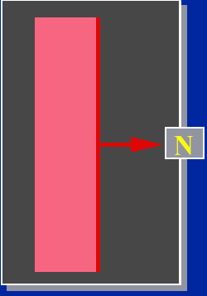
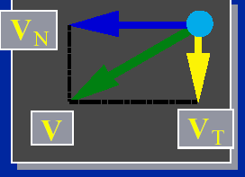
Normal and Tangential Components of Velocity
5.3.10.5 Collision Detection &Response
Notes:
Tangential
adj.切线的

Slide 62
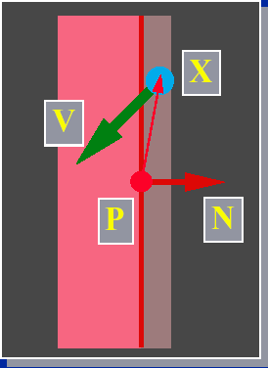
5.3.10.5 Collision Detection &Response
Within of the wall.
Heading in.

Slide 63
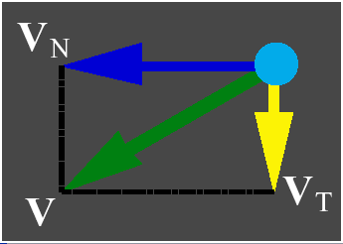
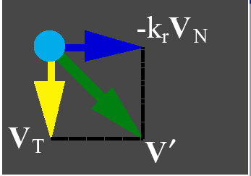
5.3.10.5 Collision Detection &Response

